Slide 1
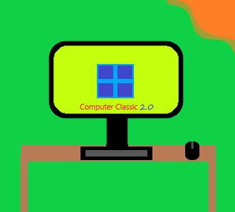
Computer 2.0 Classic
The Computer App From 2020

Slide 2
Security
The Owner or Help and Suppout cannot do any changes until you give them permission.
Someone with your username and his password will not work at logging in.
Bitlocker is here! Double the Security.

Slide 3
Features
Dark Taskbar or Light Taskbar is here.
Wallpaper can be changed.
Bitlocker and Password can be enabled or disabled.
10 min timer can be set, after it ends it locks the system.
Some of the app features can be used when using the “Continue without signing in” feature.
Password, Username and Pin can be changed.

Slide 4
New Upcoming features
Bitlocker, Password Will be Fully Released.
Private Chat Will be Fully Released.
3.0 coming soon in 2022 or 2023.

Slide 5
About
It is like a computer your using but in portrait, and it is like windows
It will have more features in new updates
App version: 2.0, Win: 2.0, UI: 3.0

